Slide 1
DLC SERVICES

Slide 2
DLC SERVICES
data link control (DLC) deals with procedures for communication between two node-to-node communication
Data link control functions include framing and flow and error control.

Slide 3
Framing
The data-link layer, needs to pack bits into frames
Framing in the data-link layer separates a message from one source to a destination by adding a sender address and a destination address.
whole message could be packed in one frame,
frame can be very large -> making flow and error control very inefficient.

Slide 4
Frame Size
Frames can be of fixed or variable size.
In fixed-size framing, there is no need for defining the boundaries of the frames; the size itself can be used as a delimiter.
An example
type of framing is the ATM WAN, which uses frames of fixed size called cells.

Slide 5
variable-size framing
Used in local-area networks. In variable-size framing,
need a way to define the end of one frame and the beginning of the next.
two approaches were used for this purpose:
a character-oriented approach and
a bit-oriented approach.

Slide 6
Data Link Layer Protocols

Slide 7
High-level Data Link Control (HDLC)

Slide 8
High-level Data Link Control (HDLC)
It is a bit-oriented protocol for communication over point-to-point and multipoint links.
It implements the Stop-and-Wait protocol
- uses both flow and error control
- In this protocol, the sender sends one frame at a time and
waits for an acknowledgment before sending the next
one.
It implements the ARQ mechanisms
-Automatic Repeat ReQuest (ARQ)
- is an error-control mechanism for data transmission which uses acknowledgements (or negative acknowledgements) and timeouts to achieve reliable data transmission over an unreliable communication link.

Slide 10
Configurations and Transfer Modes
Two common transfer modes
1. normal response mode (NRM) and
2. asynchronous balanced mode (ABM).

Slide 11
Normal response mode (NRM)
NRM - the station configuration is unbalanced. We have one primary station and multiple secondary stations.
A primary station can send commands;
a secondary station can only respond.
The NRM is used for both point-to-point and multipoint links

Slide 12
Asynchronous balanced mode (ABM)
the configuration is balanced.
The link is point-to-point, and each station can function as a primary and a secondary
(acting as peers)

Slide 13
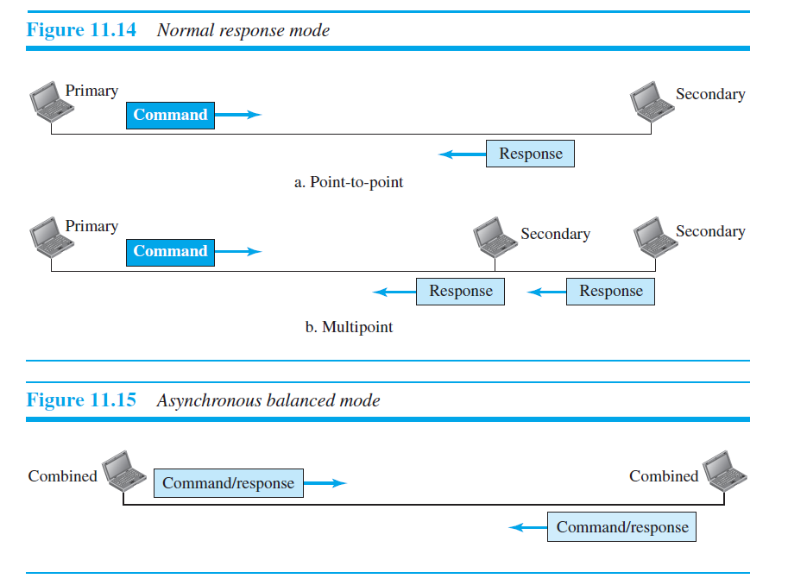

Slide 14
Framing
HDLC defines three types of frames:
information frames (I-frames) - to data-link user data and control information relating to user data (piggybacking)
supervisory frames (S-frames) - to transport control information
unnumbered frames (U-frames) - reserved
for system management

Slide 15
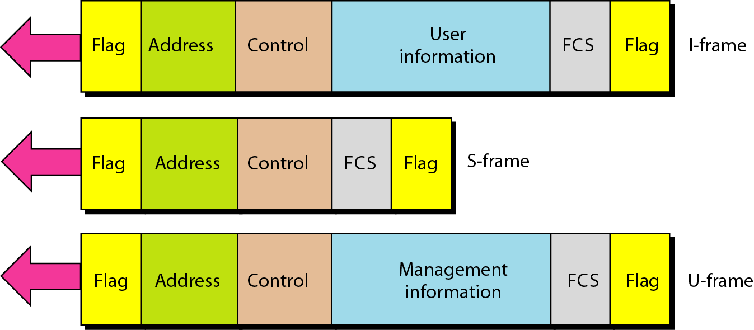
Figure 11.27 HDLC frames

Slide 16
Different frame types
Flag field - This field contains synchronization pattern 01111110, which identifies both the beginning and the end of a frame
Address field. This field contains the address of the secondary station.
If a primary station created the frame, it contains a to address.
If a secondary station creates the frame, it contains a from address.

Slide 17
Control field. The control field is one or two bytes used for flow and error control.
Information field. The information field contains the user’s data from the network layer or management information.
FCS field. The frame check sequence (FCS) is the HDLC error detection field.
It can contain either a 2- or 4-byte CRC.

Slide 18
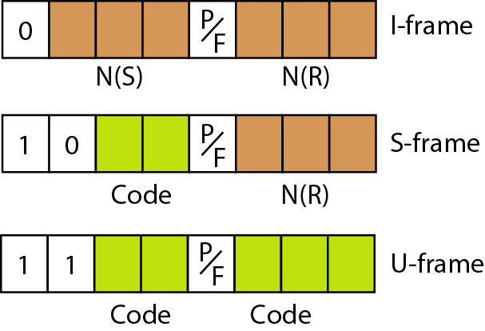
Figure 11.28 Control field format for the different frame types

Slide 19
I -frames
I-frames - to carry user data from the network layer
N(S), define the sequence number of the frame
(between 0 and 7)
N(R), set the acknowledgment number when piggybacking is used
P/F field is a single bit
Poll - the frame is sent by a primary station to a secondary ( contains the address of the receiver )
final when the frame is sent by a secondary to a
primary (the address of the sender).

Slide 20
S-Frames
used for flow and error control
acknowledgment number (ACK) or negative acknowledgment number (NAK), depending on the type of S-frame
four types of S-frames
Receive ready (RR) - > If the value of the code subfield is 00
Receive not ready (RNR)-> If the value of the code subfield is 10
Reject (REJ)-> If the value of the code subfield is 01
Selective reject (SREJ)-> If the value of the code subfield is 11

Slide 21
Control Field for U-Frames
Unnumbered frames are used to exchange session management and control information between connected devices.

Slide 22
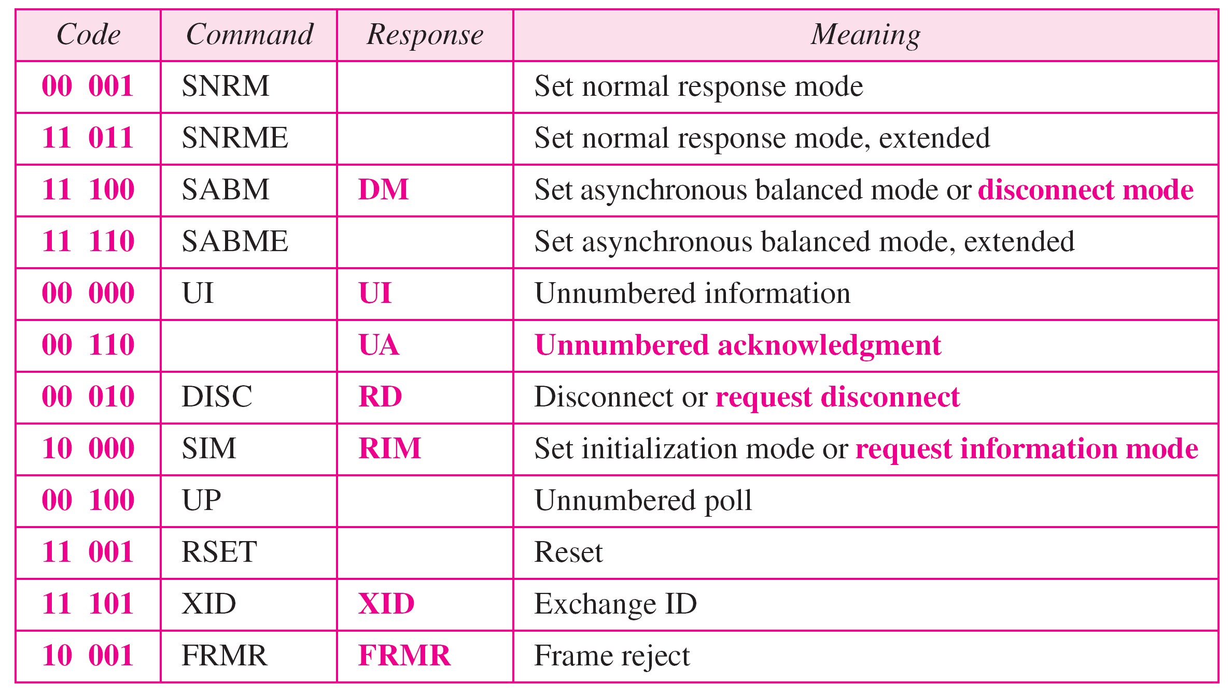
Table 11.1 U-frame control command and response

Slide 23
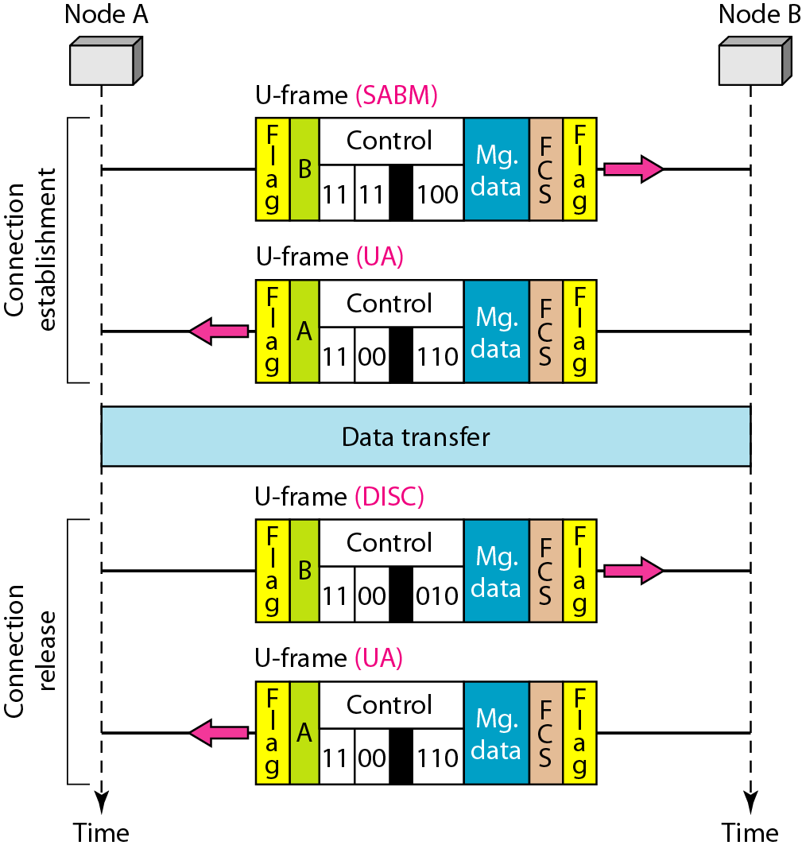
Figure 11.29 Example of connection and disconnection

